Slide 1

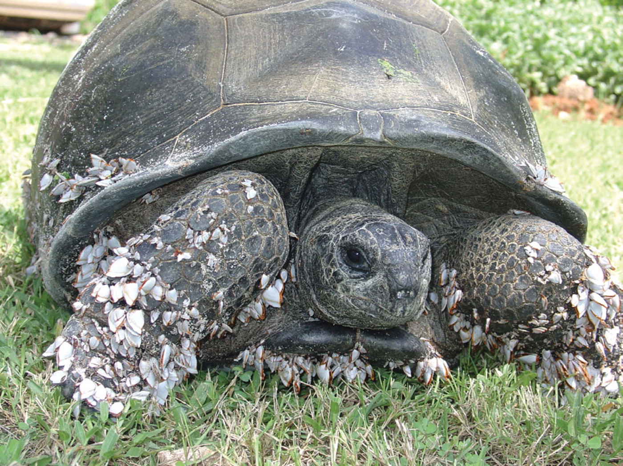
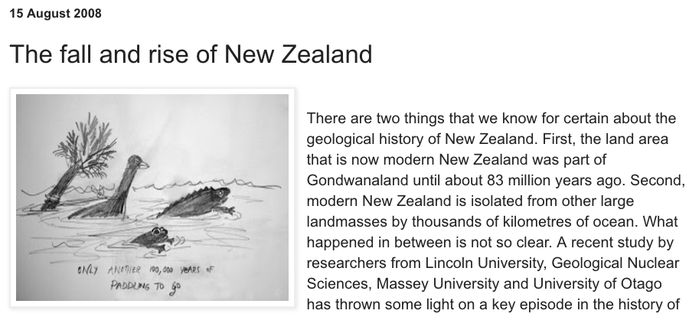
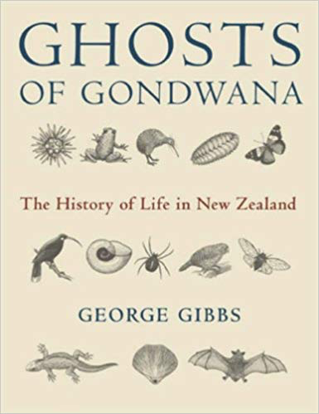
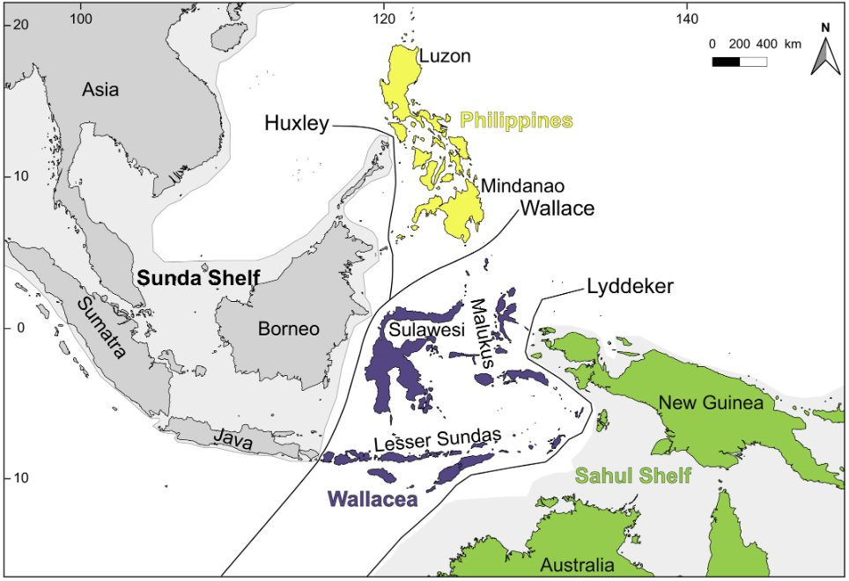
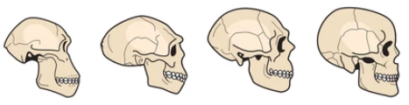
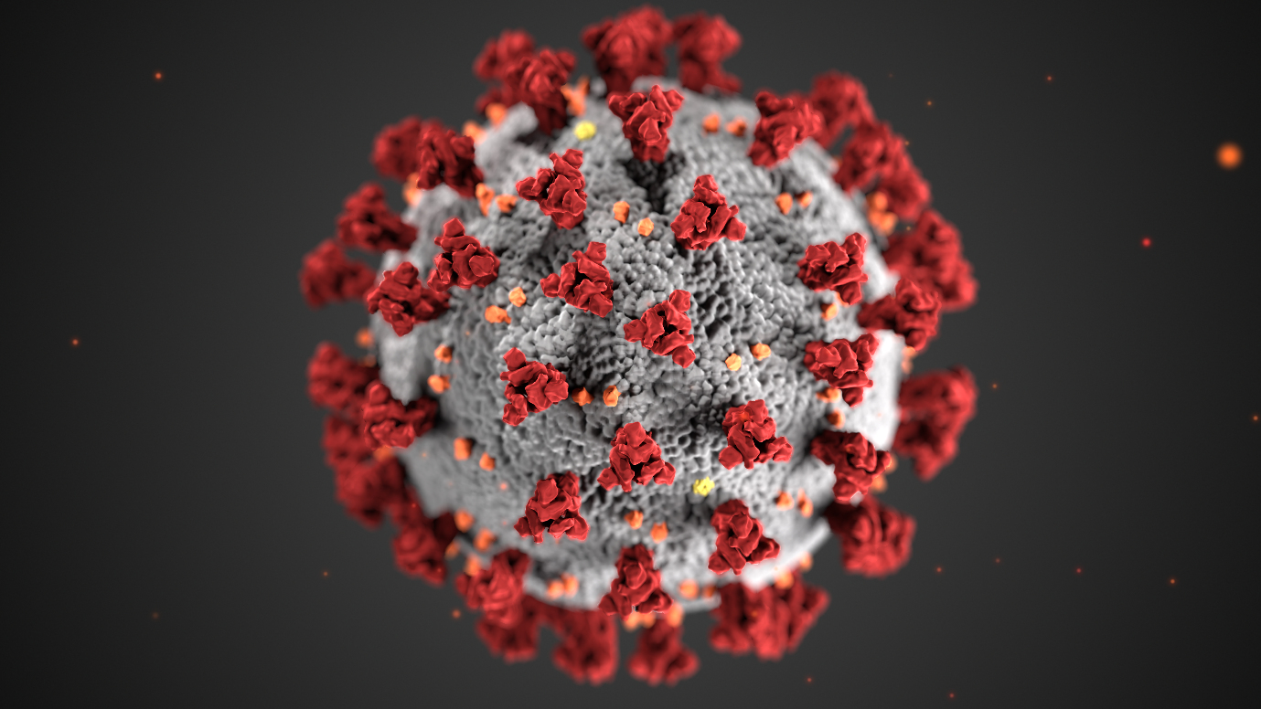
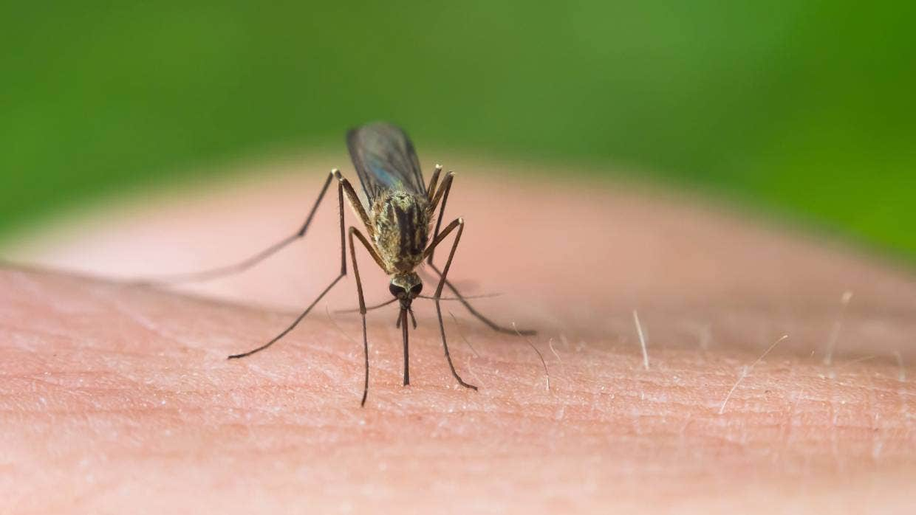
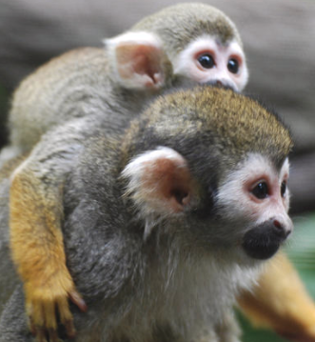
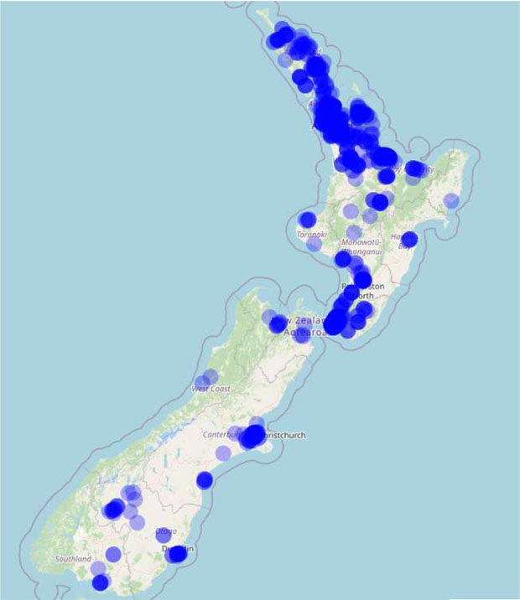
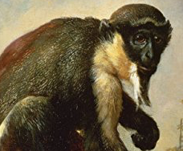
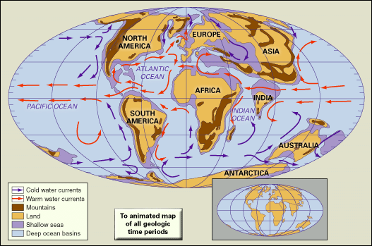
Long-distance dispersal: why study it?
It’s just interesting!
Big puzzles
www.yourlifechoices.com.au/news/where-are-australias-monkeys/
It’s fundamental to understanding the biota of Aotearoa New Zealand
No primates crossed
to Australia (before humans)
Gerlach et al (2006); Photo: C. Muir
etonstem.com/exploring-the-indo-aust
ralian-archipelago-the-wallace-line
The Monkey’s Voyage How Improbable Journeys Shaped the History of Life
Fundamental to evolution…
Biogeographical methods apply to:
Invasive species,
Climate change,
Extinction
…perhaps even human evolution
https://www.shutterstock.com/search/
Stuff: https://tinyurl.com/zzss9s9k
www.immune.org.nz/diseases/covid-19
Stuff: https://tinyurl.com/dztdjc8b
Disease spread!
Technical science problems
anthropoids
Biogeographical methods: 1000s of papers/year
Available computational methods
ignore many important processes
200 species
LDD
https://kids.britannica.com/kids/assembly/view/1702
40 Mya
1 species

Slide 2
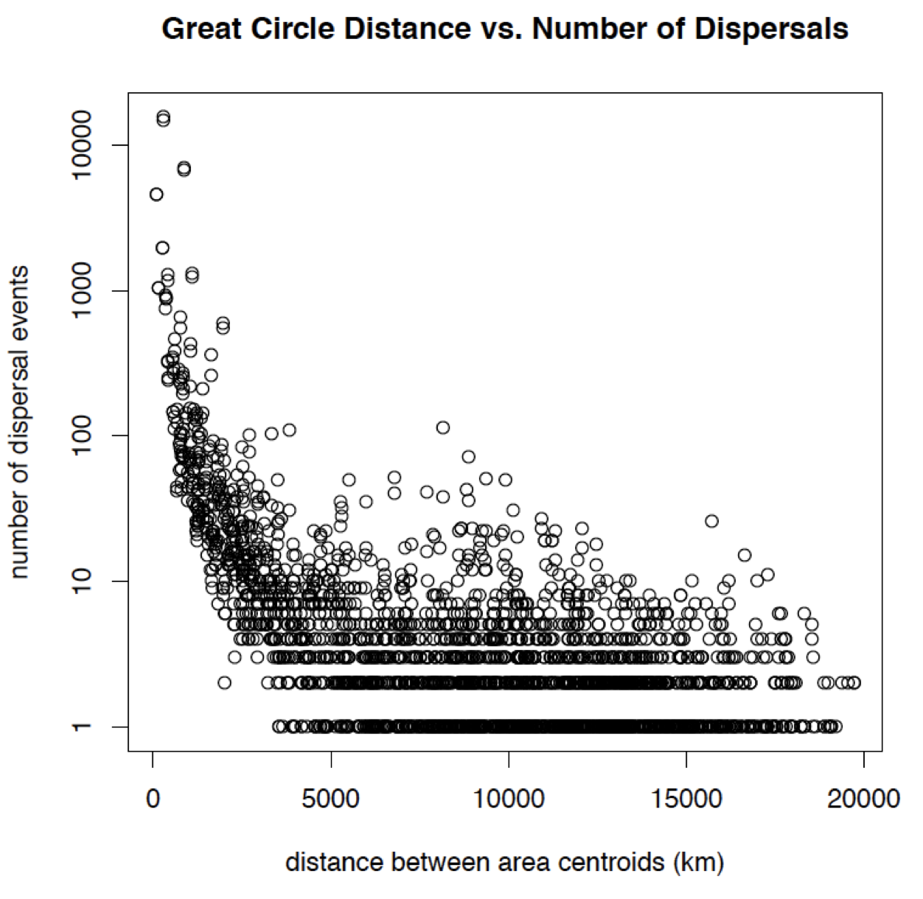
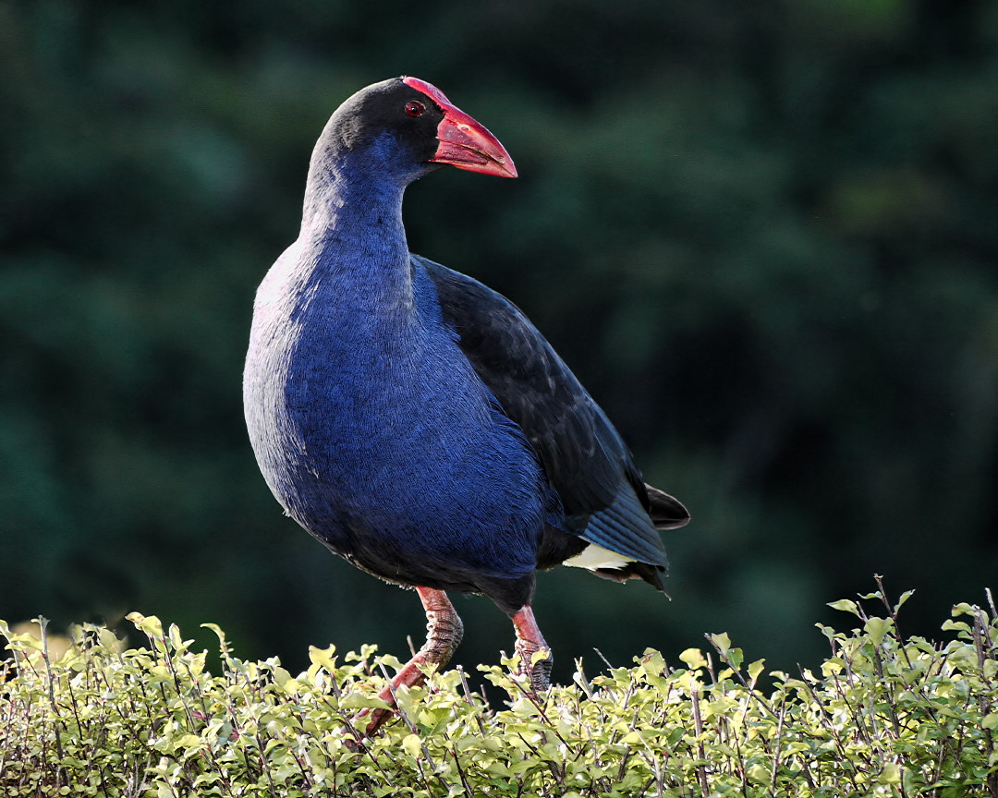
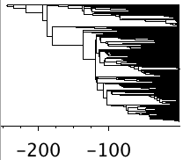
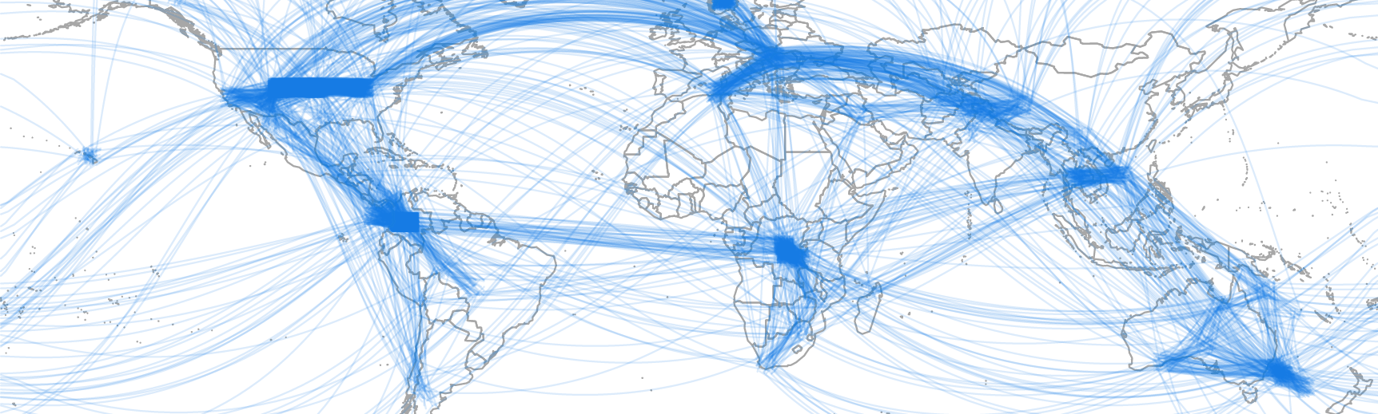
Apply to mega-phylogeny of plants: (13,000 plant species, 173 billion years of branch length)
From miracle to mechanism in biogeography
Nicholas J. Matzke, Senior Lecturer, SBS, U. Auckland
Example work: Rallidae (e.g. Pukeko)
Garcia-R; Matzke (2021) Journal of Biogeography
13,000 Plants: # dispersals vs. distance
(Preliminary data)
CORE QUESTION: What explains these apparently “miraculous” long-distance dispersals?
# dispersal events
1 10 100 1,000 10,000
753 citations
21 workshops on 5 continents
59 publications, 20 since coming to Auckland
0 5,000 10,000 15,000 20,000
distance between biomes (km)
BioGeoBEARS-sampled history of dispersals
(Tree from: Zanne et al. 2013)
BioGeoBEARS-sampled history of dispersals
200 Ma 100 Ma 0
(Bayesian Biogeographic
Stochastic Mapping)
Notes:
I want to convince you that these miracles are explainable - tortoises
173 billion years of branch length in this phylogeny

Slide 3
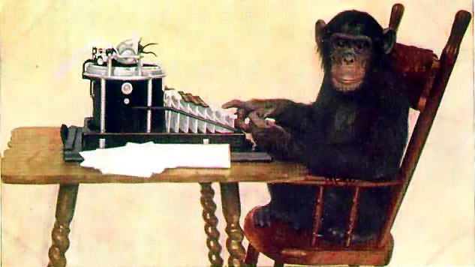
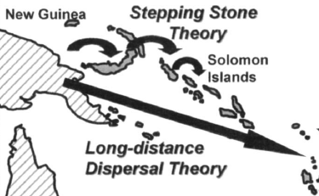
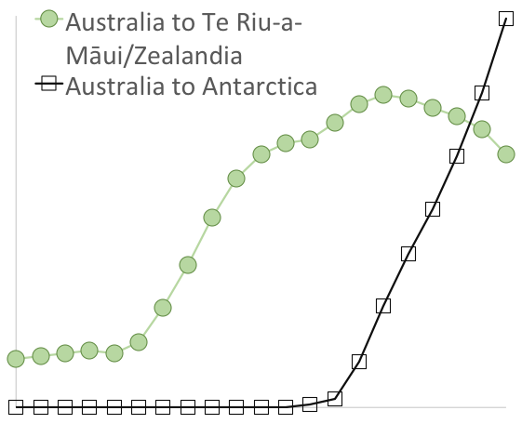
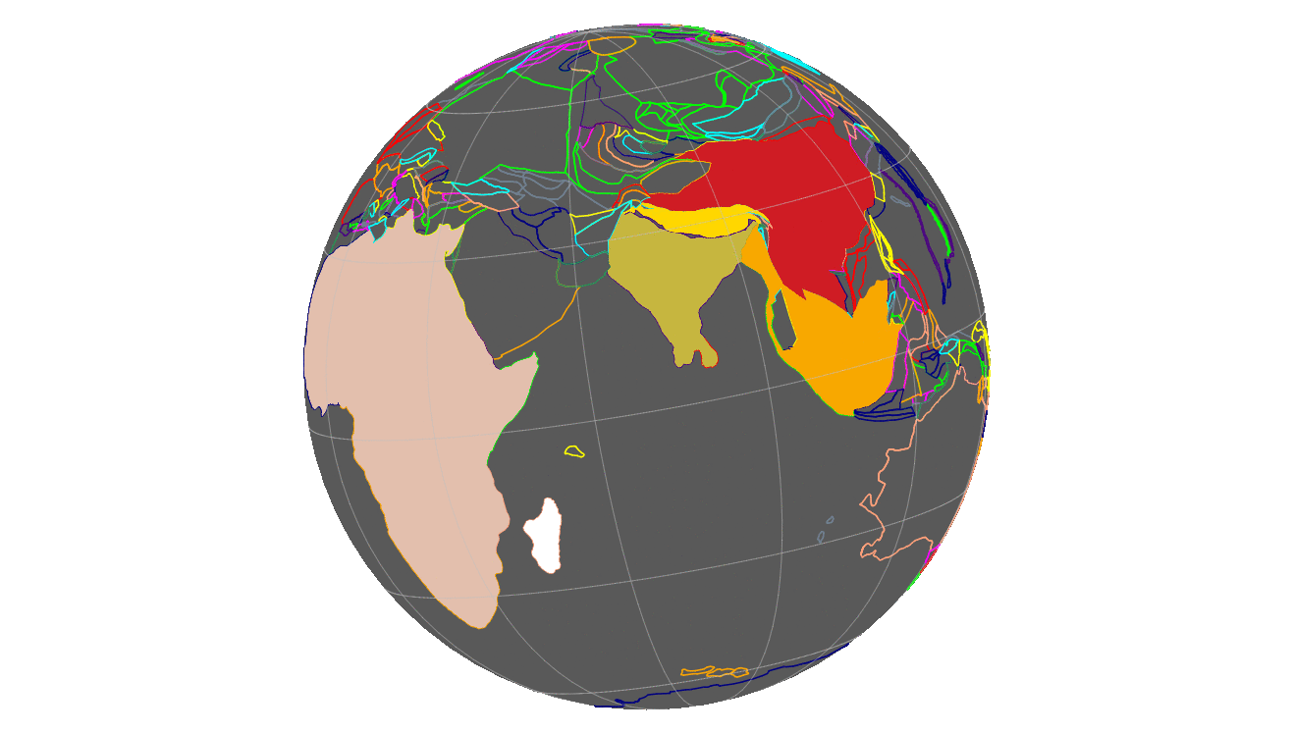
Possible LDD Explanations (Hypotheses)
H0
Null hypothesis: “It’s just luck.”
Can we reject this?
Long-distance dispersals:
Island
“stepping stones”
# dispersal events
H1
Keppel et al. 2009
H2
Changing palaeodistances
0 km 10,000 km 20,000 km
H3
Changing palaeoclimates
0 km 500 km 1000 km
I I I
Hx:
H4
Palaeo-winds & currents
I I I
Artefact Hypothesis: Extinction makes fake LDDs
100 Mya 50 Ma 0 Ma
Living + fossil species:
Living-only species:
GPlates: Sabin Zahirovic, U. Sydney
Animation: Wallis Bland (Marsden Fast-Start Ph.D. student)
A
A
F
A
A
F
C
D
E
B
many short dispersals
One long-distance dispersal
A
B
C
D
E
F
A
F
…plus obvious factors like: current distances, connectivity, evolving traits (Matzke 2016-2021)
Notes:
I want to convince you that these miracles are explainable - tortoises
173 billion years of branch length in this phylogeny

Slide 4
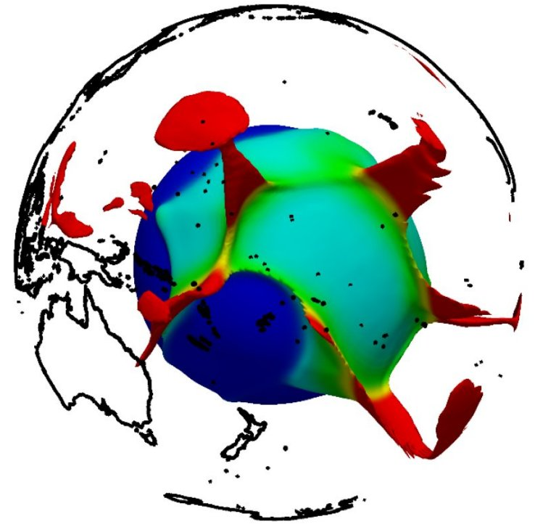
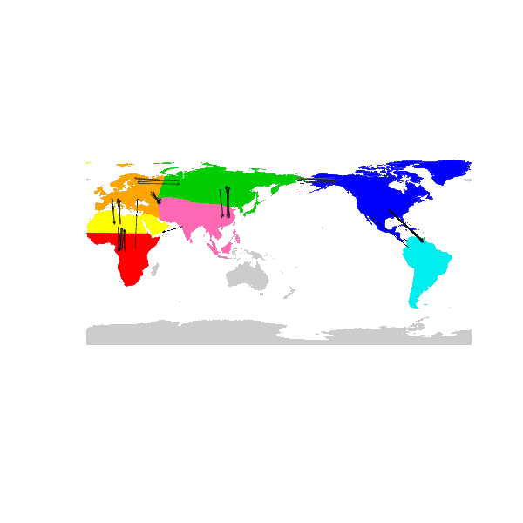

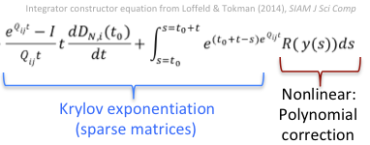
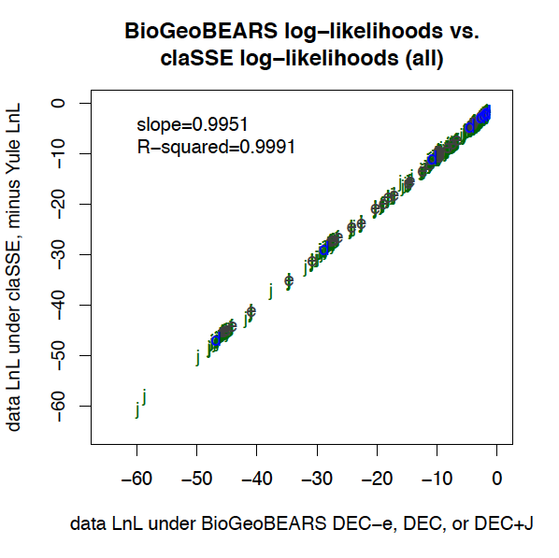
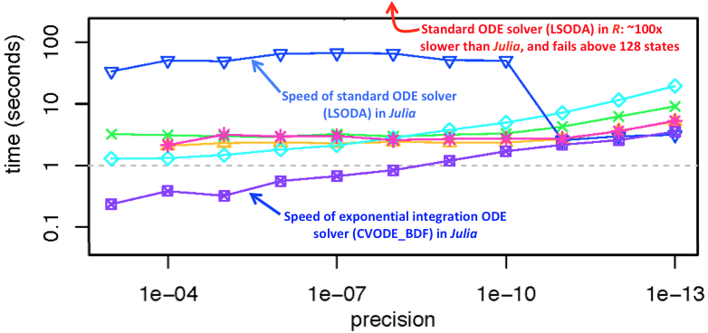
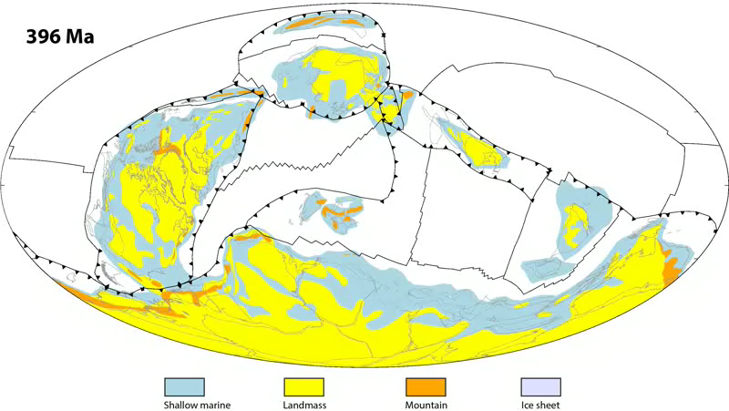
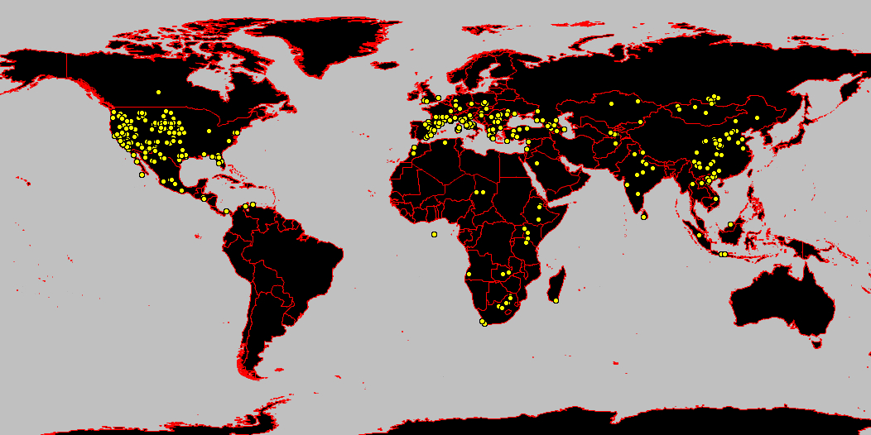
The Big Stretch: Integration for Realism
Marsden Fast-Start
Problem: Extinction + Biogeography=SLOW
Rutherford H1: Stepping stones
improve
model fit
Rutherford H4: Palaeocurrents / winds improve fit
Not just current islands - Past plume islands accessible!
kids.britannica.com/kids/assembly/view/1702
10 areas = 2048 ODEs = too slow
40 Mya
GPlates integrated; EarthByte.org
Solution:
BioGeo
Exponential integrators:
Goal: Realistic, accurate biogeog.
Compare candidate models using AIC, Bayes
Statistically sample histories
Saila & Matzke (2018) SVP
Matzke (2021) J. Biogeography, accepted
Matzke (2020) NZ Phylogenomics
Rutherford H2, H3: Palaeogeography, Palaeoclimates improve model fit
Paleobiology Database: Fossil Canidae (Saila & Matzke, 2018)
Cao, Zahirovic et al. (2017), BioGeoSciences: “Improving global paleogeography since the late Paleozoic using paleobiology.”

Slide 5


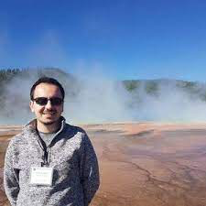
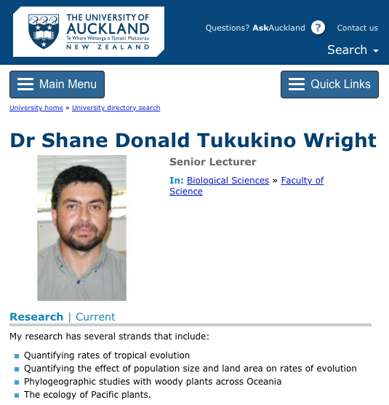
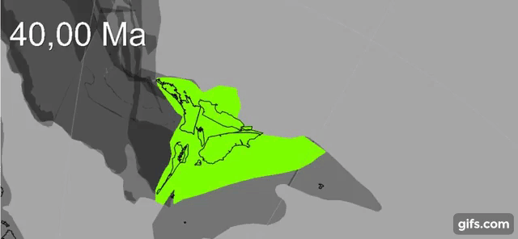

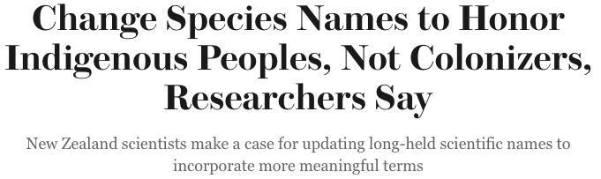
The Team. The Plan.
Biogeography:
current status
Expertise:
Lead author of GPlates
Plate tectonics
Palaeogeography
The Biogeographical Jump
Forwards:
+ Ph.D. student 1
Plant, Squamate, Amphibian,
Mammal, Bird
megaphylogenies
+ Ph.D. student 2
Te Riu-a-Māui/Zealandia
Expertise:
Pacific biogeography
Plant dispersal
Palaeoclimate of NZ and region
Indigenous names in taxonomy
Müller, Sahirovic et al. (2018), U. Sydney "Modelling and visualising distributed crustal deformation of Australia and Zealandia using GPlates 2.0.”
Notes:
Shane is Te Ati HauNui-a-Paparangi, Whanganui region

Slide 6

Understanding LDD: Benefits
This Rutherford Project will:
determine how much apparent LDD is artefactual
measure the relative importance of LDD mechanisms
provide tools for including palaeogeography, palaeoclimate, and other dynamic factors in the ODEs necessary for realistic spatial phylogenetics
E.g. for epidemiology
Broader impacts
Training workshops at meetings (21 workshops on 5 continents so far)
Joint visualisations of geographic & biogeographic history (classrooms, museums)
Advance NZ leadership in open-source code, data for education
“…explain New Zealand and the world falls into place around it.”
--JRSNZ (2021), call for papers, Evolutionary Biogeography of Aotearoa New Zealand; citing Gareth Nelson (1975).
Understand Aotearoa’s biota in global context
“The past is the key to the present.”
--anthology on Charles Lyell, “Father of Geology”
“I walk backwards into the future with my eyes fixed on my past.” / “Kia whakatōmuri te haere whakamua.”
--Lesley Rameka (2016). Contemp. Iss. Early Child. 17(4), 387-398.
Notes:
Rameka (2016) article says this proverb “expresses the Māori perspective of time, where the past, present and future are intertwined, and life is a continuous cosmic process.”

